Slide 1


Poem Generator using NLP techniques
BUAN 6342
APPLIED NATURAL LANGUAGE PROCESSING

Slide 2

3 techniques-
Text Generation
Text to Image
Text to Speech

Slide 3
Text Generation
To train this model we are using poems extracted by web scraping from a website written by Edgar Allan Poe , specifically "https://mypoeticside.com."
For Web Scraping – we used FancyURLOpener from URL library
urllib.request.FancyURLopener
DataFrame named poems is created with columns 'title' and 'text' using the extracted data.DataFrame is saved to a CSV file named 'allan_poems.csv’
This code asks the user to input an initial word, generates a poem based on that word using SpaCy for natural language processing, and prints the formatted poem to the console. The poem is created by selecting sentences with high similarity to the previous sentence.

Slide 4
Text to image
To convert the poem into an image we used a pretrained model called
"PixArt-XL-2-1024-MS"
from the PixArtAlphaPipeline, specifically using the PyTorch library.
The poem generated before is taken as input and based on the text Image is generated.

Slide 5
Text to Speech
We have used Hugging Face Transformers and datasets libraries to generate speech from a given poem text using the Microsoft SpeechT5 model.
It incorporates speaker embeddings from the CMU Arctic dataset and writes the resulting speech to a WAV file.
Here, the poem generated for the input word given by us is taken as text and a WAV file is generated for it.

Slide 6
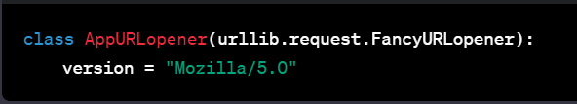
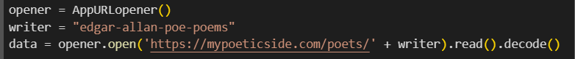
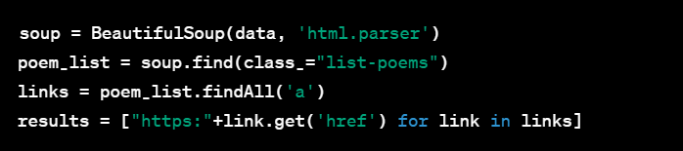
This Python code appears to be a web scraping script that extracts poems written by Edgar Allan Poe from a website, specifically "https://mypoeticside.com."
This code defines a custom class AppURLopener that inherits from urllib.request.FancyURLopener. It sets the version attribute to "Mozilla/5.0," which is a common User-Agent string used by web browsers
This section creates an instance of AppURLopener named opener. It then opens the URL "https://mypoeticside.com/poets/edgar-allan-poe-poems" using this opener, reads the HTML content, and decodes it.
The HTML content is parsed using BeautifulSoup. It finds the element with the class "list-poems" and extracts all hyperlinks (<a> tags) within that element. It then constructs a list results containing the full URLs by appending "https:" to each link.

Slide 7
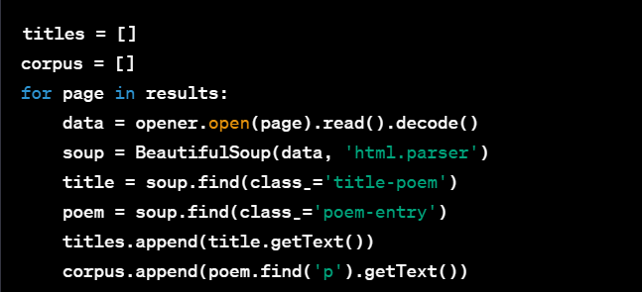
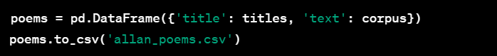
It iterates over the URLs in the results list, opens each URL, and extracts the title and content of each poem. The titles are stored in the titles list, and the poem content is stored in the corpus list.
DataFrame named poems is created with columns 'title' and 'text' using the extracted data.
It then saves this DataFrame to a CSV file named 'allan_poems.csv'.

Slide 8
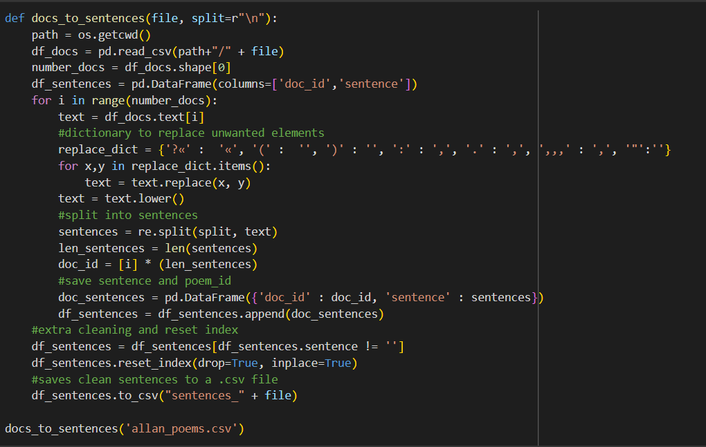
This code takes a CSV file containing poems, cleans and processes the text, extracts individual sentences, and saves the cleaned sentences along with their corresponding document IDs to a new CSV file.

Slide 9
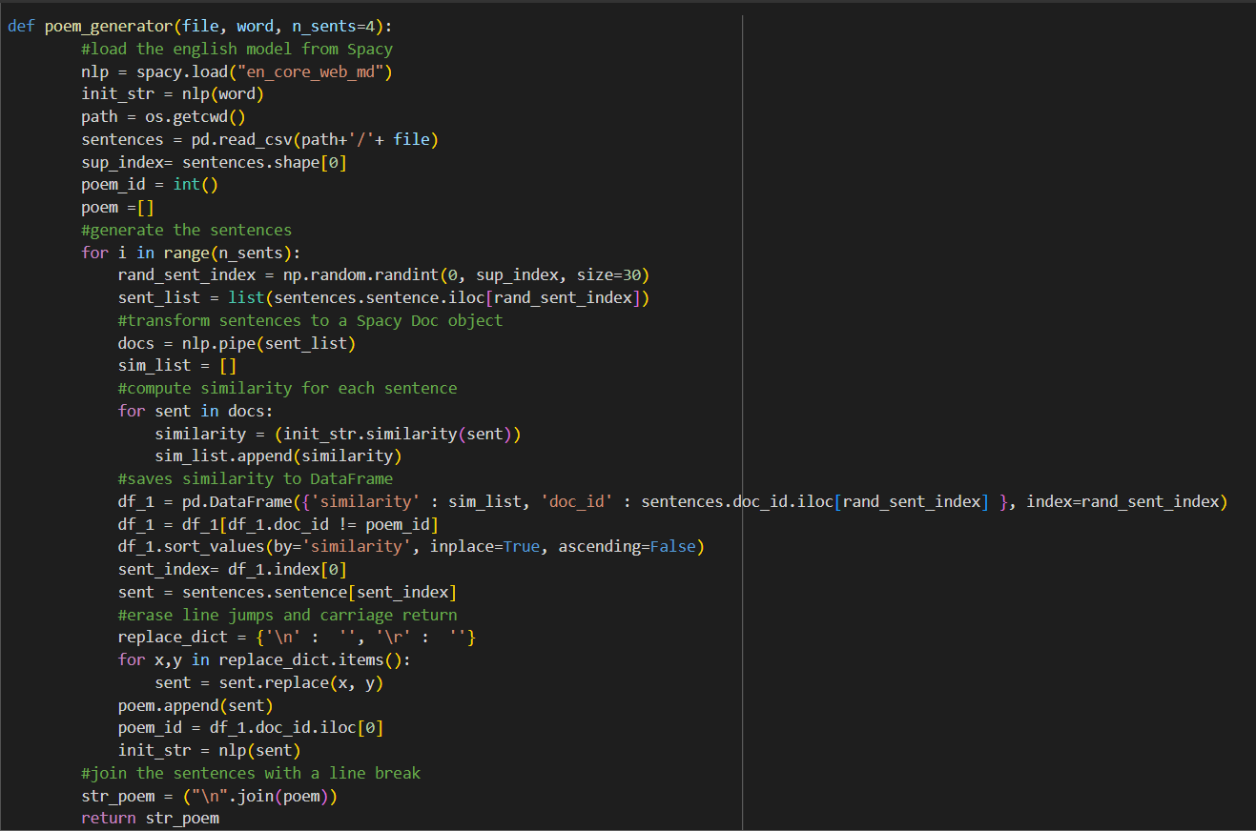
Function named poem_generator that generates a poem based on a given word.
The function uses SpaCy for natural language processing and relies on a pre-existing CSV file containing sentences.
sup_index: Number of sentences in the DataFrame.
poem_id: A variable to keep track of the document ID of the last sentence added to the poem.
poem: An empty list to store the generated poem.
The function generates a poem by iteratively selecting the most similar sentences to the previous one based on SpaCy's word similarity metric. It uses a CSV file of sentences and relies on the SpaCy library

Slide 10
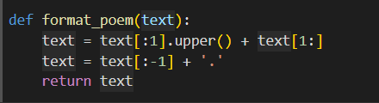
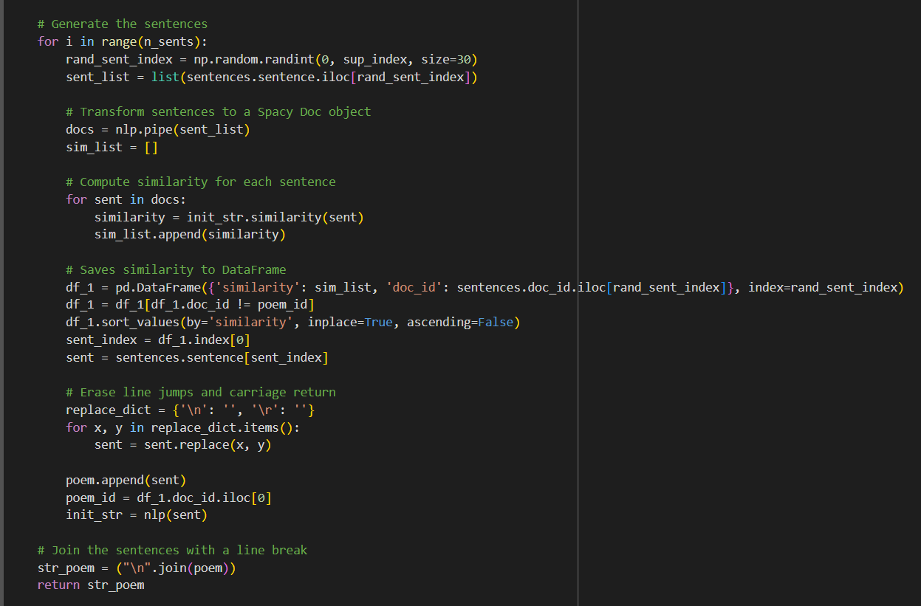
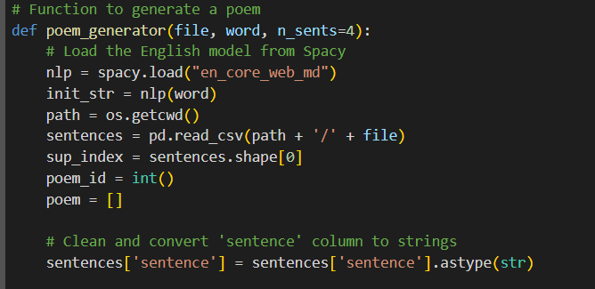
The format_poem function capitalizes the first letter of the input text and ensures that the poem ends with a period. This kind of formatting is often used to ensure consistency and readability in written text, especially when dealing with sentences or lines of poetry.

Slide 11
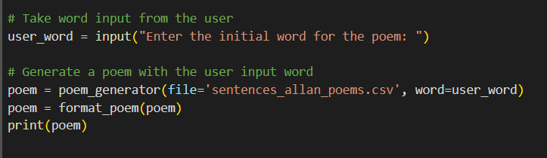
It prompts the user to enter an initial word for the poem and then calls the poem_generator function to generate a poem based on the provided word.
This code allows the user to input an initial word, generates a poem based on that word using SpaCy for natural language processing, and prints the formatted poem to the console. The poem is created by selecting sentences with high similarity to the previous sentence.

Slide 12
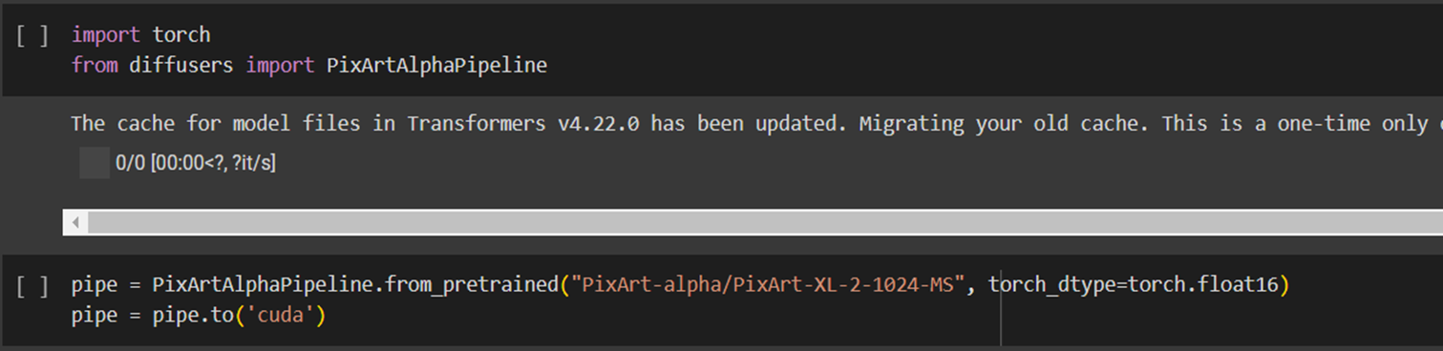
The model appears to be associated with image processing or computer vision, given the mention of "PixArt.“
PixArtAlphaPipeline: This is likely a custom class or module that encapsulates a machine learning pipeline for image processing tasks.
from_pretrained: This method is commonly used in machine learning frameworks like Hugging Face's Transformers library. It loads a pretrained model based on the provided identifier or path.
"PixArt-alpha/PixArt-XL-2-1024-MS": This is the identifier or path for the pretrained model to be loaded.
torch_dtype=torch.float16: It specifies the data type to be used in PyTorch tensors. In this case, it uses the torch.float16 data type, which represents half-precision floating-point numbers.
Then we move the entire PixArtAlphaPipeline, including the loaded pretrained model, to the CUDA device, which usually means moving it to a GPU. The string argument 'cuda' indicates that it's moving the model to the GPU. This assumes that a GPU is available and PyTorch is configured to use it.
to('cuda'): This is a PyTorch method used to move a model or tensor to a specified device. 'cuda' refers to the GPU

Slide 13
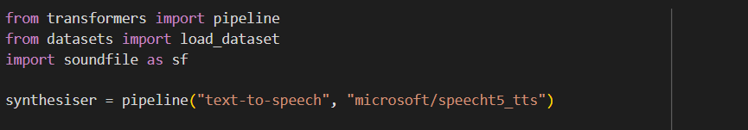
The code imports necessary libraries:
pipeline from transformers: This is used to easily create a pipeline for various NLP tasks, including text-to-speech.
load_dataset from datasets: This is used to load a dataset, particularly the CMU Arctic dataset in this case.
soundfile as sf: This is used to write the generated speech to a WAV file.
It creates a text-to-speech pipeline using the Microsoft SpeechT5 model. The pipeline function from Hugging Face Transformers simplifies the process of using pre-trained models for various natural language processing tasks.

Slide 14
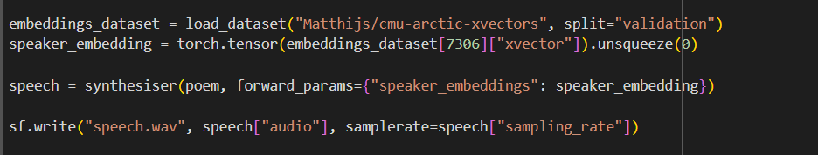
It loads the CMU Arctic dataset, specifically the speaker embeddings, using the load_dataset function from the datasets library.
It extracts the speaker embedding tensor for a specific sample from the dataset and converts it into a PyTorch tensor. The unsqueeze(0) method adds an extra dimension to the tensor, making it suitable for input to the model
It generates speech from the provided poem text using the text-to-speech pipeline. Additionally, it passes the speaker embedding tensor as a forward parameter to the pipeline, allowing the model to consider the specified speaker characteristics during synthesis.
It uses the soundfile library to write the generated speech audio to a WAV file named "speech.wav." The audio data is obtained from the speech dictionary, and the sampling rate is specified.

Slide 15
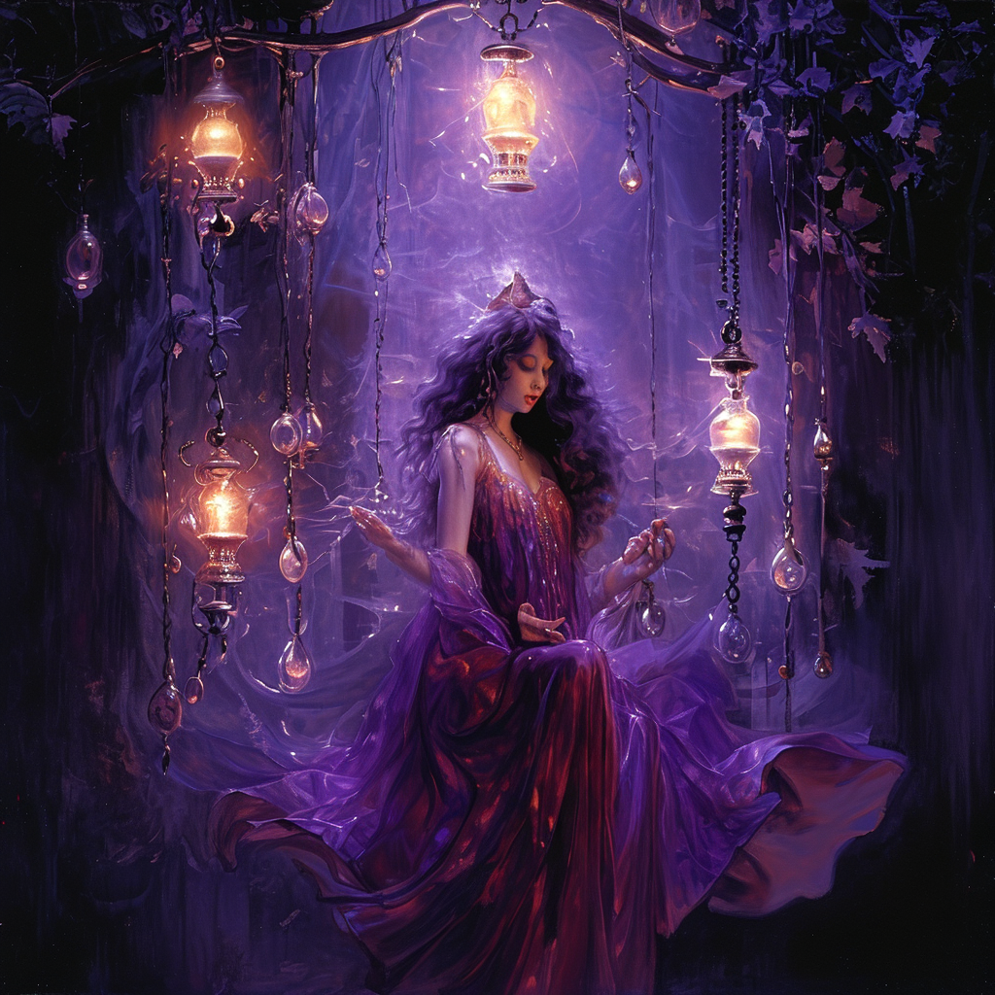
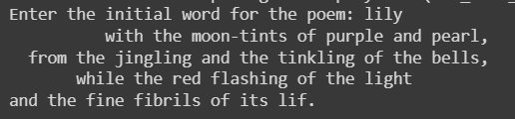

Outputs:
Image output:
Input text : Lily
Text output :
Audio output :

Slide 16


Thank you!!
VIKRANT SAGAR REMODDULA
(VXR220005)
MAHITA CHARAGONDLAA
(MXC220010)

